Slide 1

Expanding Feeasy Through Real Estate, Family Planning & Weddings:
A Path to $200m in Originations
Group 2: Leah Khan, Johannes Lang, Adrian Murawski, John Pagliarulo, Dhruvi Dinesh Nisar
Notes:
AI-generated content may be incorrect. --- This presentation outlines Feeasy's strategic plan to grow its business by expanding from its current real estate loan focus into solar installation and wedding planning funding markets. We will explore integration opportunities, market assessments, and financial strategies.

Slide 2



Growth Roadmap
Integrating Solar Panels as current Real Estate Vertical
Diversifying Into Family Planning Industry
Wedding Planning
X
X
X
Phase 1
Phase 2
Phase 3

Slide 3
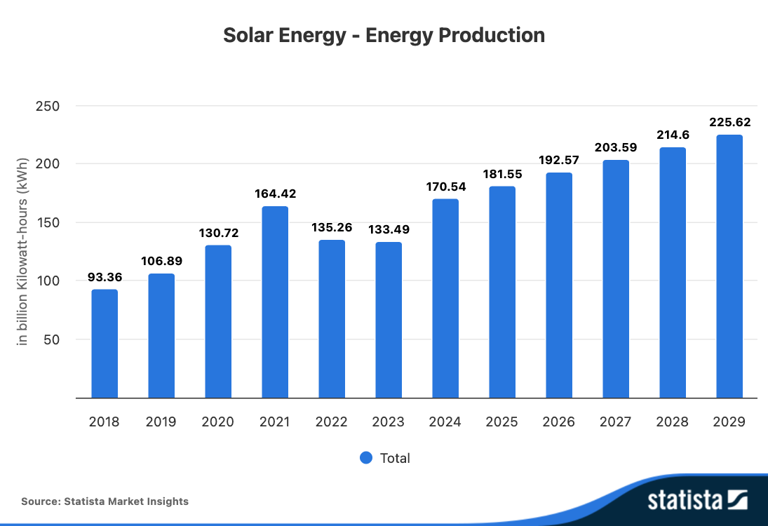
Market Overview
Rapid Market Growth
Green Energy Financing Demand
Notes:
The solar installation market is expanding quickly driven by rising demand for renewable energy solutions.
There is increasing need for innovative financing options to support solar energy adoption and sustainability.

Slide 4
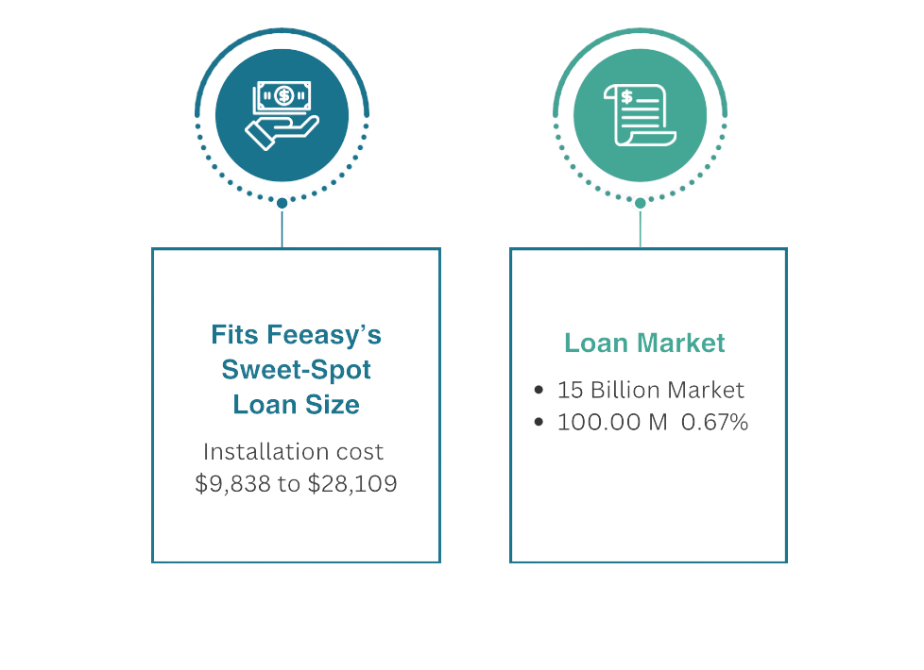
Market Overview
*https://www.woodmac.com/news/opinion/major-financiers-capitalise-on-a-growing-us-residential-solar-market/
Notes:
--- The solar market is rapidly growing with increasing demand for green energy financing. Analyzing market data and customer needs will inform Feeasy’s approach to providing tailored funding solutions. Image source: Microsoft 365 content library

Slide 5
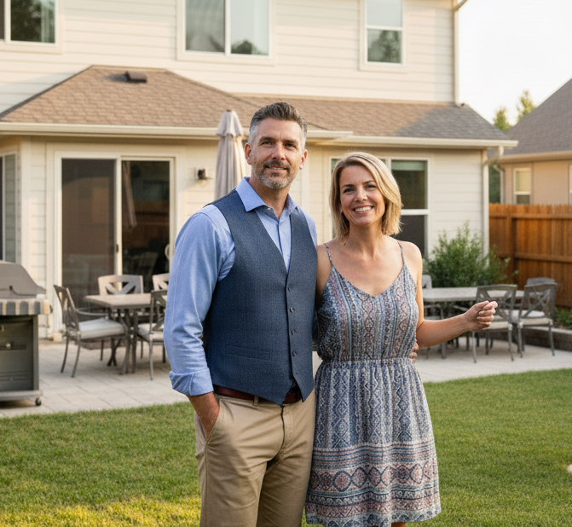
Customer Profile
Income
$117k median
Locale
Suburban
Age
35-55 years old
Motive
Cost Savings

Slide 6
Common Financing of Solar Panels
 | Pros | Cons
Cash | No interest payments | Large upfront investment
Home Equity Loan | Lower interest rates | Home is used as collateral
Personal Loan | Fast process, home is not at risk | Generally higher interest rates
Solar Loan | $0 down, low monthly payments | terms up to 25 years
Notes:
Paying the full cost of the solar system upfront.
Pros: Highest long-term savings (no interest payments),
Cons: Requires a large upfront investment
Personal Loan (Unsecured):
Standard loan from a bank or lender based on creditworthiness, not secured by home.
Pros: The process is fast, home is not at risk
Cons: Interest rates are generally higher and loan terms are shorter, leading to higher monthly payments. Requires good credit for favorable rates.
Home Equity Loan:
Borrowing against home's equity to pay for the system.
Pros: Interest rates are typically lower than other loans
Cons: Home is used as collateral, putting it at risk of foreclosure.
Solar Loan (Specialized):
Specifically for solar projects, often offered through installer with long terms (10-25 years). It's the most common financing method.
Pros: Often requires $0 down, and long terms keep monthly payments low.
Cons: The total cost over the life of the loan is higher due to interest and potential "dealer fees" that increase the principal. Many are structured to require a large prepayment using federal tax credit.

Slide 7
Feeasy’s Advantage
Best Rate
Feeasy
Zero Risk to Credit Score
Flexible Loan
Fast, Simple, Online
Notes:
Why It’s Better
✅ 1. Easier to Handle Unexpected Costs
If your installer finds you need a $1,500 electrical upgrade, a flexible loan lets you increase the amount quickly without starting over. Rigid loans may require a full re-approval.
✅ 2. Matches Real Project Flow
Solar projects often have permits, inspections, and roof work delays. A flexible loan can delay funding until the system passes inspection, so you’re not paying interest early.
✅ 3. Tax Credit Timing
Many flexible loans allow you to apply your tax credit later without penalty or payment increase right away — giving you time to receive your refund and pay down the balance.
✅ 4. Easier Cash Flow Management
If your payments can be recalculated after you make a lump-sum payment (like from your tax credit), you can lower your monthly payments rather than just shortening the term.

Slide 8
Marketing
03
Sales person
Commission based salary for loan originations
Contact Solar Vendors
Associations
Vendors
01
02
Build relationships
Partner with Associations and Vendors
Notes:
--- The solar market is rapidly growing with increasing demand for green energy financing. Analyzing market data and customer needs will inform Feeasy’s approach to providing tailored funding solutions. Image source: Microsoft 365 content library

Slide 9
Customers Journey
Interest in Solar panels
Customer applies through or website
2
4
1
3
Partner Firm refers us
Win/Win/Win
Notes:
--- The solar market is rapidly growing with increasing demand for green energy financing. Analyzing market data and customer needs will inform Feeasy’s approach to providing tailored funding solutions. Image source: Microsoft 365 content library

Slide 10
Potential Partners
Solar Vendors that offer financing service
All Season Solar
EcoSmart Home Services
Sunlight Solar Energy
3
Solar Vendors that offer no financing service
EmPower Solar
SUNation Energy
Solar Liberty
2
Associations
ASES National Solar Tour
NYSEIA
SEIA
1
Notes:
--- The solar market is rapidly growing with increasing demand for green energy financing. Analyzing market data and customer needs will inform Feeasy’s approach to providing tailored funding solutions. Image source: Microsoft 365 content library

Slide 11
Association Events
2025-2026
 | Oct | Nov | Dec | Jan-Sept | Oct-Dec
ASES
NYSEIA
SEIA
2026
Solar 26 Oct 19-21
Virtual Meetings
Solar Summit Nov 12
Tennessee Oct 28-30
Illinois Dec 3-4
Arizona Nov 5
Webinar Dec 10
Webinar Nov 12
Missouri Nov 13-14
Webinar Nov 18
Virginia Nov 18-19

Slide 12
Action plan
End of Q4
Week Oct 28
Week Nov 11
Week Nov 25
Week Dec 9
Week Dec 23
Workstream
Association Partnerships
Join Associations
built contact list
Join first Webinar
Create outreach template
Begin outreach
1st meeting
Sign first partnership
Plan Q1
Vendor Partnerships
Finalize list of key vendors
Built contact list
Create outreach template
Begin outreach
1st meeting
Sign first partnership
Plan Q1
Loan Originations
Set origination goal and KPIs
First loan originations
Review KPIs

Slide 13

Second Vertical:
Family Planning Industry
Notes:
Beyond real estate, Feeasy aims to enter the solar installation and wedding planning funding markets. This section evaluates market trends, opportunities, and strategic approaches for these new verticals.

Slide 14
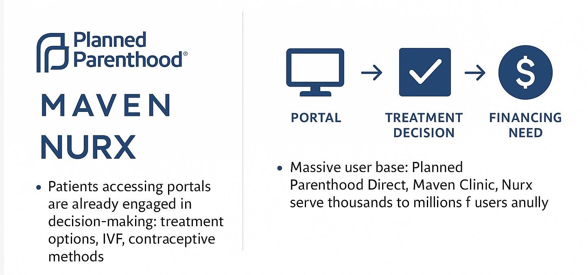
Family Planning Industry

Slide 15
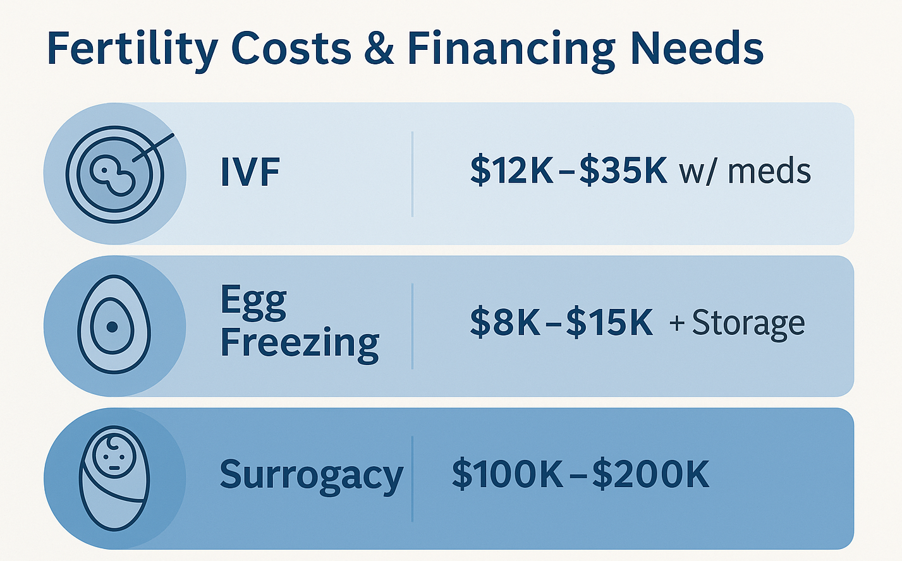

Slide 16
Family Planning: Market Strategy
Strategic Approach:
API Integration: Connect Feeasy to patient portals and telehealth apps. Offers appear instantly, pre-qualified.
Use CRM retargeting: Follow up email/SMS for unfinished applications.
Point-of-Need Financing Model: Patients booking services: “See Your Financing Options” button.
Promotion Strategy:
Partnership Marketing: Collaborate with Planned Parenthood & Key Associations:
National Family Planning & Reproductive Health Association (NFPRHA)
American Society for Reproductive Medicine (ASRM)
The National Infertility Association
Social Media: Campaigns targeting women aged 25–45.
Trade Shows: Exhibit at fertility/healthcare fintech conferences.

Slide 17
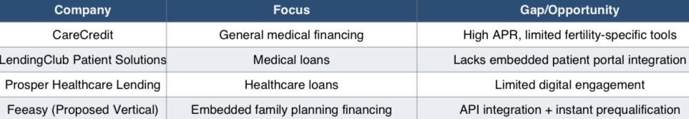

Competitor Analysis

Slide 18

Third Vertical:
Wedding
Industry
Notes:
Beyond real estate, Feeasy aims to enter the solar installation and wedding planning funding markets. This section evaluates market trends, opportunities, and strategic approaches for these new verticals.

Slide 19

Exploring the Wedding Planning Segment
$75k
10%
Average cost of NYC wedding
Amount of couples that use financing options
Aligns with Feeasy’s target audience
2.5m weddings a year
250k potential applications
Notes:
--- Wedding planning presents a unique funding opportunity with specific demographic and financial requirements. Understanding these factors will guide Feeasy in designing competitive loan products. Image source: Microsoft 365 content library

Slide 20
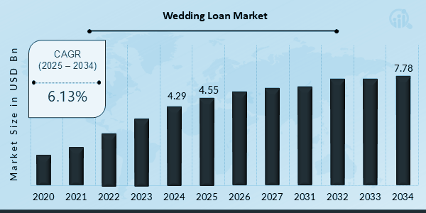
Wedding Loan Market Analysis
Feeasy’s Market Share Approach
With a market poised to reach $5b+ annually, Feeasy can originate over $50m of loans with only a 1% market share.
Notes:
--- Feeasy’s roadmap involves market research, tailored product development, and marketing strategies to differentiate itself in the solar and wedding funding spaces while leveraging existing platform strengths. Image source: Microsoft 365 content library

Slide 21
Wedding Planning: Competitive analysis
Lenders | Max Loan | Wedding Financing? | Vendor Integration Model | Differentiation vs. Feeasy
SoFi | $100,000 |  | No vendor partnerships | No POS financing; slow payout
LightStream | $100,000 |  | Traditional underwriting | Not embedded at booking
Mariner Finance | $25,000 | Indirect only
Lending Club | $40,000 | Indirect only
FEEASY | $100,000 | Yes — Purpose-built wedding financing | Integrated with planners and venues | Instant approvals + 24hr payout
Indirect (Personal loans)
Indirect (Personal loans)
No digital vendor integration
Low loan limits; not wedding-fit
Marketplace lending
Consumer-only; no B2B model

Slide 22
Wedding Planning: Market Strategy
Roadmap to Enter the Wedding Financing Market
Partner with Wedding Planners – Leverage planners as trusted advisors to introduce Feeasy as part of the budgeting process.
Event Presence – Sponsor The Event Planner Expo to reach 2,500+ planners and 150+ vendors.
Collaborate with Venues – Integrate Feeasy into NYC venue booking systems for seamless financing options.
Partnership Marketing – Cross-promote Feeasy through planner newsletters and vendor networks.
Create Mutual Value – Help vendors close deals faster while Feeasy captures high-credit clients.
Digital Outreach – Target engaged couples on Instagram, TikTok, and The Knot using “Finance Your Dream Wedding through Feeasy.”

Slide 23
Customer Journey
Vendor Gets Paid Upfront
Vendor or Planner Recommends Feeasy
Financing introduced as part of budgeting conversation
Funds disbursed within 24 hours → improves vendor cash flow
Discovery
Apply & Approve
Vendor Payout
Referral & Repeat
Instant Pre-Qualification In-Platform
Referral & Repeat Pipeline
Planners + venues incentivized to recommend Feeasy to future clients
“See Your Financing Options” button in booking system → real-time approval

Slide 24
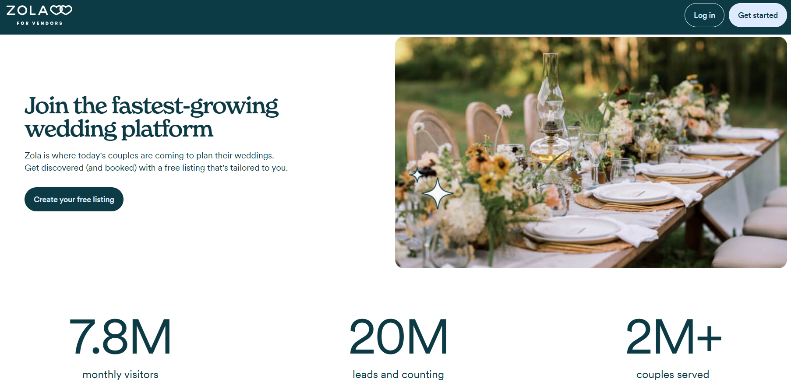
Wedding Planning: Market Strategy
Features:
Free to Join
Over 250 Venues
400+ Wedding Venues

Slide 25

How Does Feeasy Get There
Notes:
Beyond real estate, Feeasy aims to enter the solar installation and wedding planning funding markets. This section evaluates market trends, opportunities, and strategic approaches for these new verticals.

Slide 26
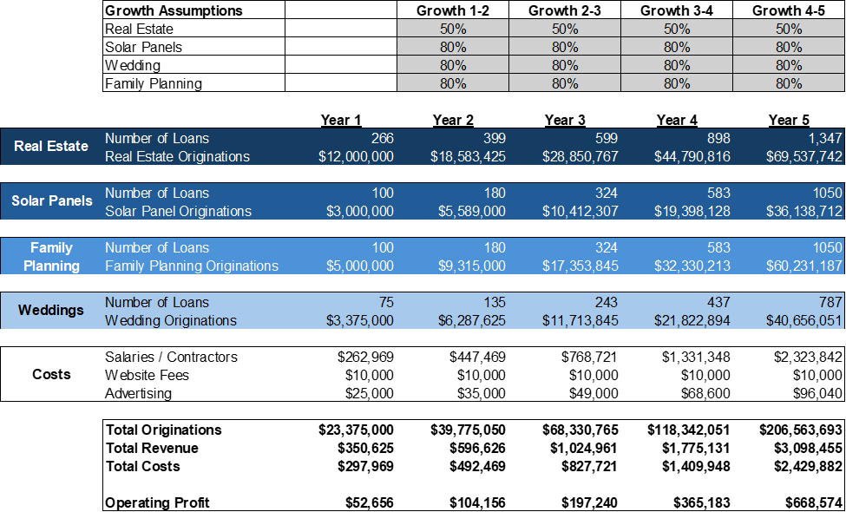
Five-Year Growth Plan

Slide 27
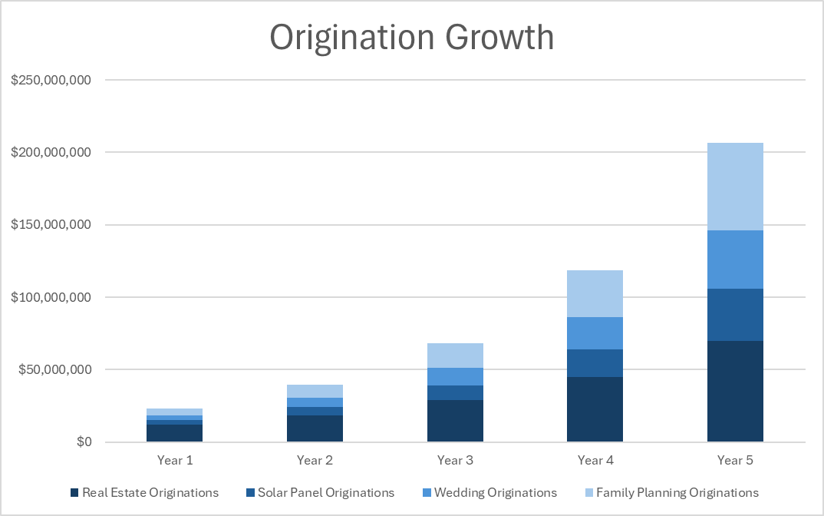
Five-Year Growth Plan

Slide 28
Valuation Estimates
Company |  | Originations | Enterprise Value | Multiple
SoFi |  | $29,500,000,000 | $35,650,000,000 | 1.21
World Acceptance |  | $1,440,000,000 | $1,460,000,000 | 1.01
Lending Club |  | $8,000,000,000 | $1,080,000,000 | 0.14
Upstart Holdings |  | $8,000,000,000 | $6,180,000,000 | 0.77
Oportun Financial |  | $2,000,000,000 | $2,890,000,000 | 1.45
Feeasy Loan Originations |  |  | $206,563,693
Feeasy Valuation (Low) |  |  | $27,886,099
Feeasy Valuation (High) |  |  | $298,484,537

